Slide 1
Section 10.3
The Complex Plane;
De Moivre’s Theorem
Copyright © 2012 Pearson Education, Inc. Publishing as Prentice Hall.

Slide 2
Copyright © 2012 Pearson Education, Inc. Publishing as Prentice Hall.

Slide 3
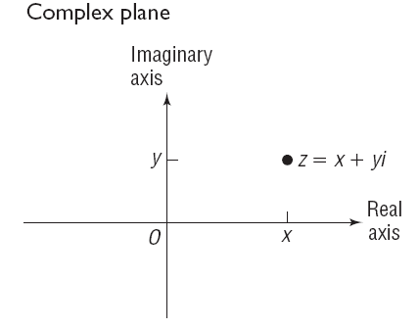
Copyright © 2012 Pearson Education, Inc. Publishing as Prentice Hall.

Slide 4

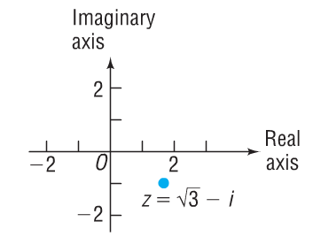
Copyright © 2012 Pearson Education, Inc. Publishing as Prentice Hall.

Slide 5
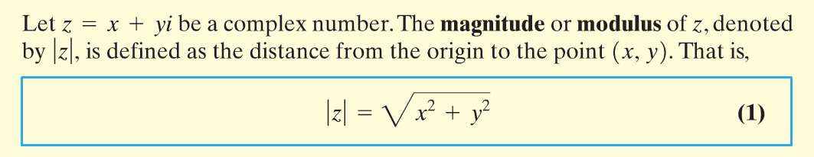
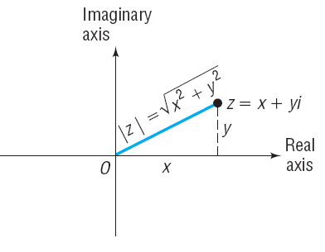

Copyright © 2012 Pearson Education, Inc. Publishing as Prentice Hall.

Slide 6

Copyright © 2012 Pearson Education, Inc. Publishing as Prentice Hall.

Slide 7
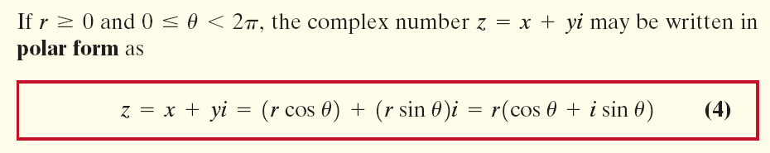
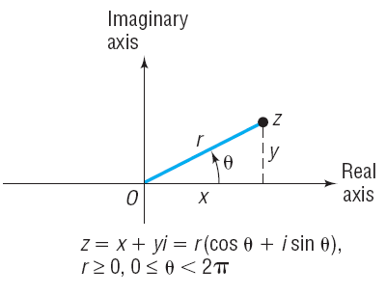

Copyright © 2012 Pearson Education, Inc. Publishing as Prentice Hall.

Slide 8


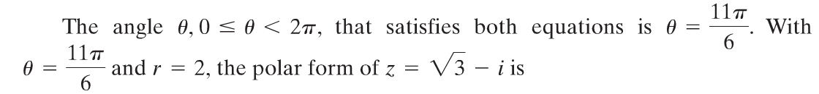

Copyright © 2012 Pearson Education, Inc. Publishing as Prentice Hall.

Slide 9
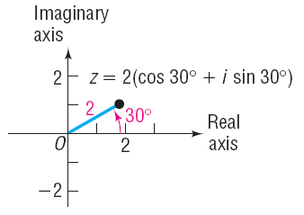
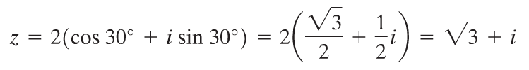
Copyright © 2012 Pearson Education, Inc. Publishing as Prentice Hall.

Slide 10
Copyright © 2012 Pearson Education, Inc. Publishing as Prentice Hall.

Slide 11

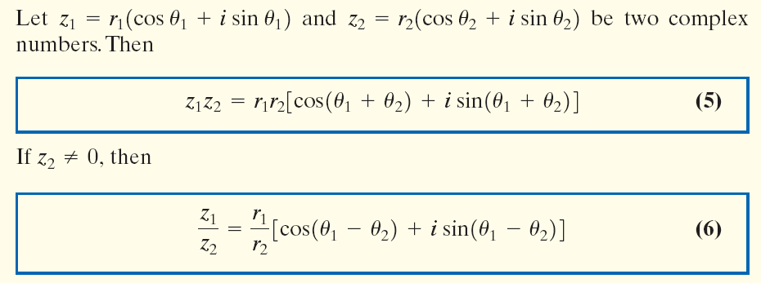
Copyright © 2012 Pearson Education, Inc. Publishing as Prentice Hall.

Slide 12
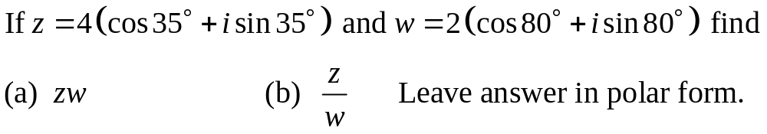
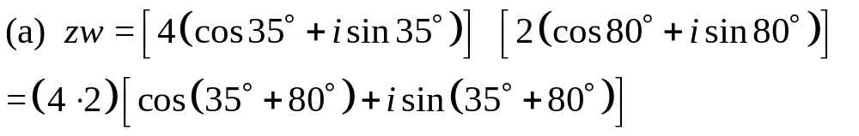

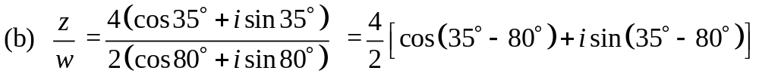

Copyright © 2012 Pearson Education, Inc. Publishing as Prentice Hall.

Slide 13

Copyright © 2012 Pearson Education, Inc. Publishing as Prentice Hall.

Slide 14
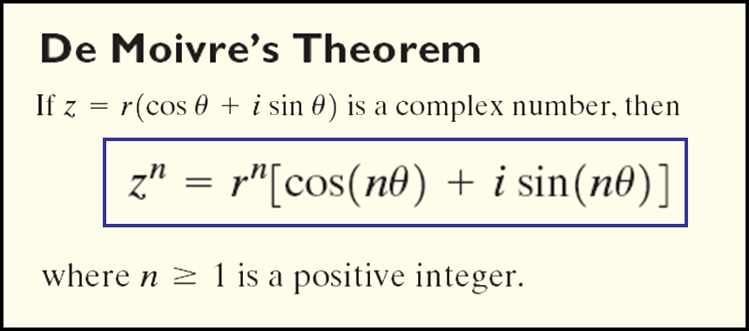
Copyright © 2012 Pearson Education, Inc. Publishing as Prentice Hall.

Slide 15
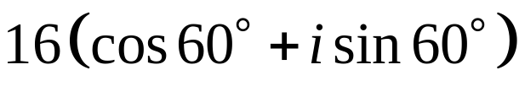
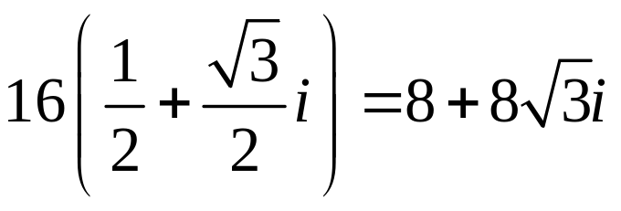

Copyright © 2012 Pearson Education, Inc. Publishing as Prentice Hall.

Slide 16
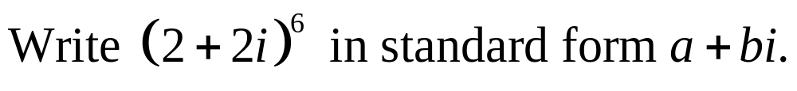
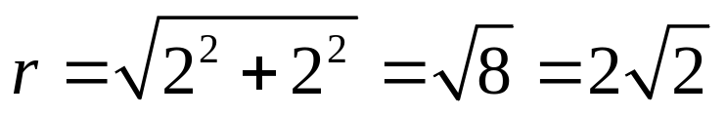
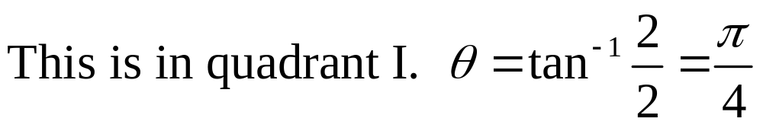
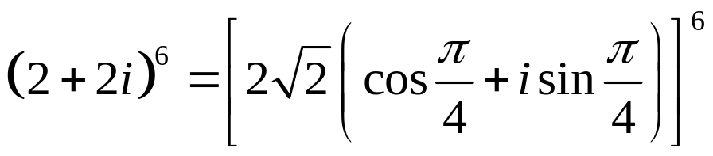
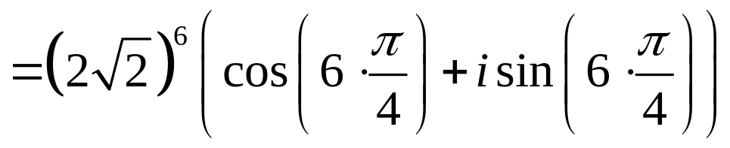
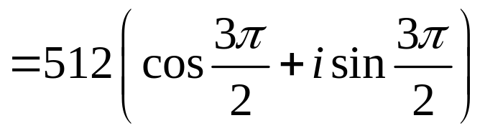
Copyright © 2012 Pearson Education, Inc. Publishing as Prentice Hall.

Slide 17

Copyright © 2012 Pearson Education, Inc. Publishing as Prentice Hall.

Slide 18
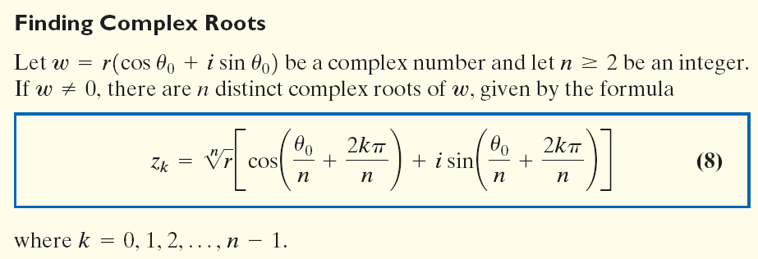
Copyright © 2012 Pearson Education, Inc. Publishing as Prentice Hall.

Slide 19


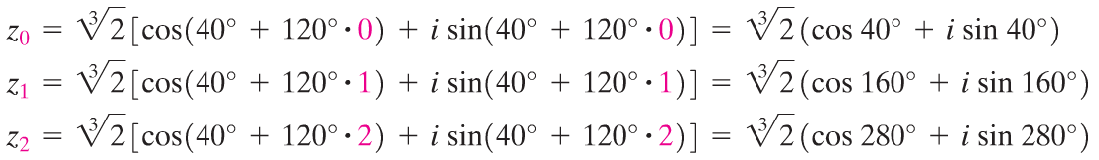

Copyright © 2012 Pearson Education, Inc. Publishing as Prentice Hall.

Slide 20
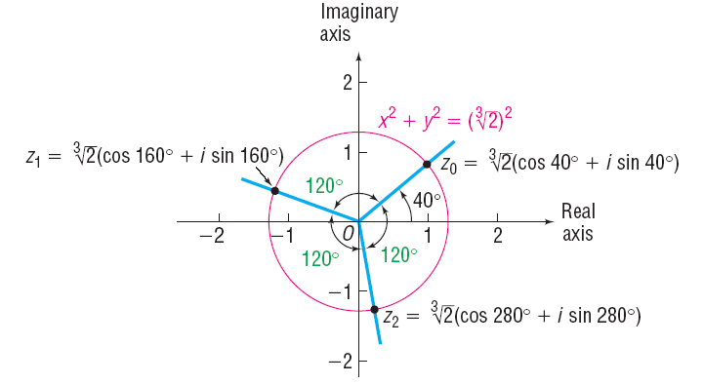
Copyright © 2012 Pearson Education, Inc. Publishing as Prentice Hall.

